Slide 1

CEIS 110 Introduction to Programing
Lakisha Snipe
Devry University

Slide 2



Introduction
Python is an easy-to-learn, versatile, and in-demand programming language with a strong community and vast library of modules. It's a valuable skill for students preparing for the job market.
Python is a popular high-level programming language that is widely used for various purposes, including web development, scientific computing, data analysis, artificial intelligence, and machine learning. It has a simple and easy-to-understand syntax, making it an ideal language for beginners to learn. Python is open-source, free to use, and has a large community of developers who contribute to its development and maintenance.

Slide 3

Downloading weather data

Slide 4
Design and Library setup
Start
Install Python Modules
In this Project we created something called a flow chart.
A flowchart graphically represents the flow of a program.
1. Install Python Modules
2. Download Weather Data to a Database
3. Extract Weather Data to CVS file
4. Cleanse Weather Data
5. Use Excel to manipulate the data
6. Use Python Data analytics modules to develop graphical modules
Download Weather Data to a database
Extract Weather Data into CSV file
Cleanse Weather Data
Use Excel to manipulate the Data
Use Python data analytics modules to develop graphical models
End

Slide 5
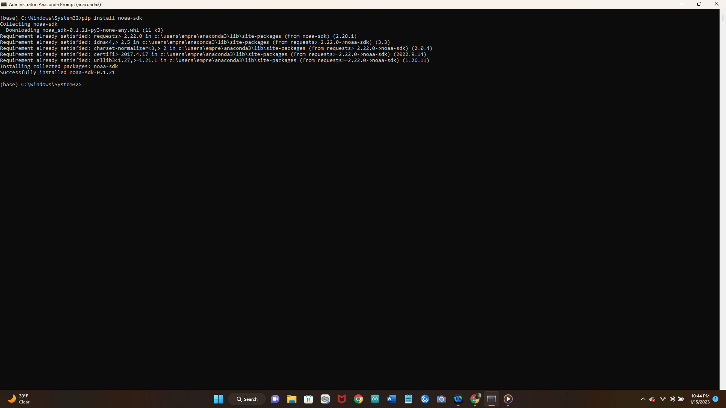
Software Inventory (Screenshots
Include screenshot of NOAA-SDK library installed
Ensure result "Successfully installed noaa-sdk" of pip install command is visible in your screenshot.
In order for Python to connect to the NOAA weather data service using cloud based application programing a library module must be installed

Slide 6
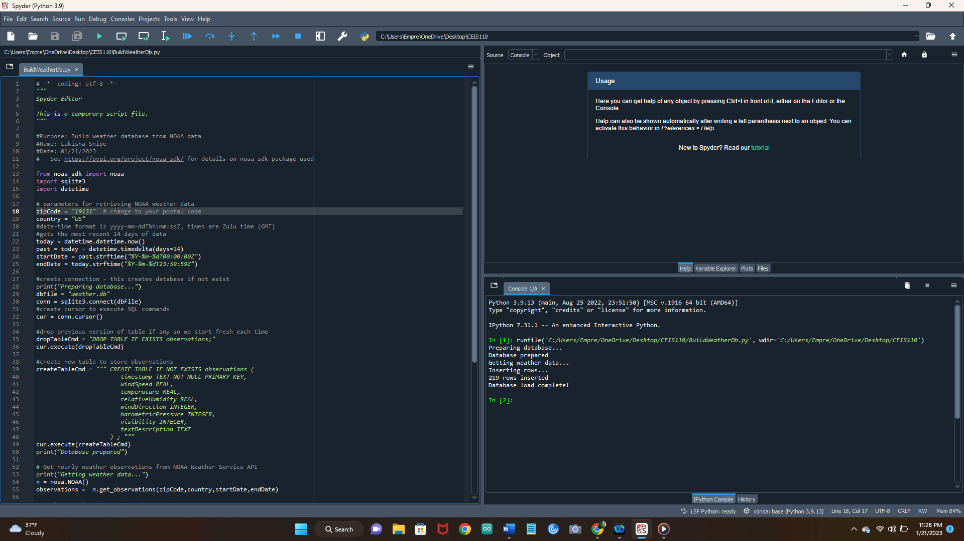
BuildWeatherDb.py Code This is a code tracking the weather for the City I live in. After planning a design, the code was developed to download a set of weather observations. The Data was stored on a local database for later use.

Slide 7
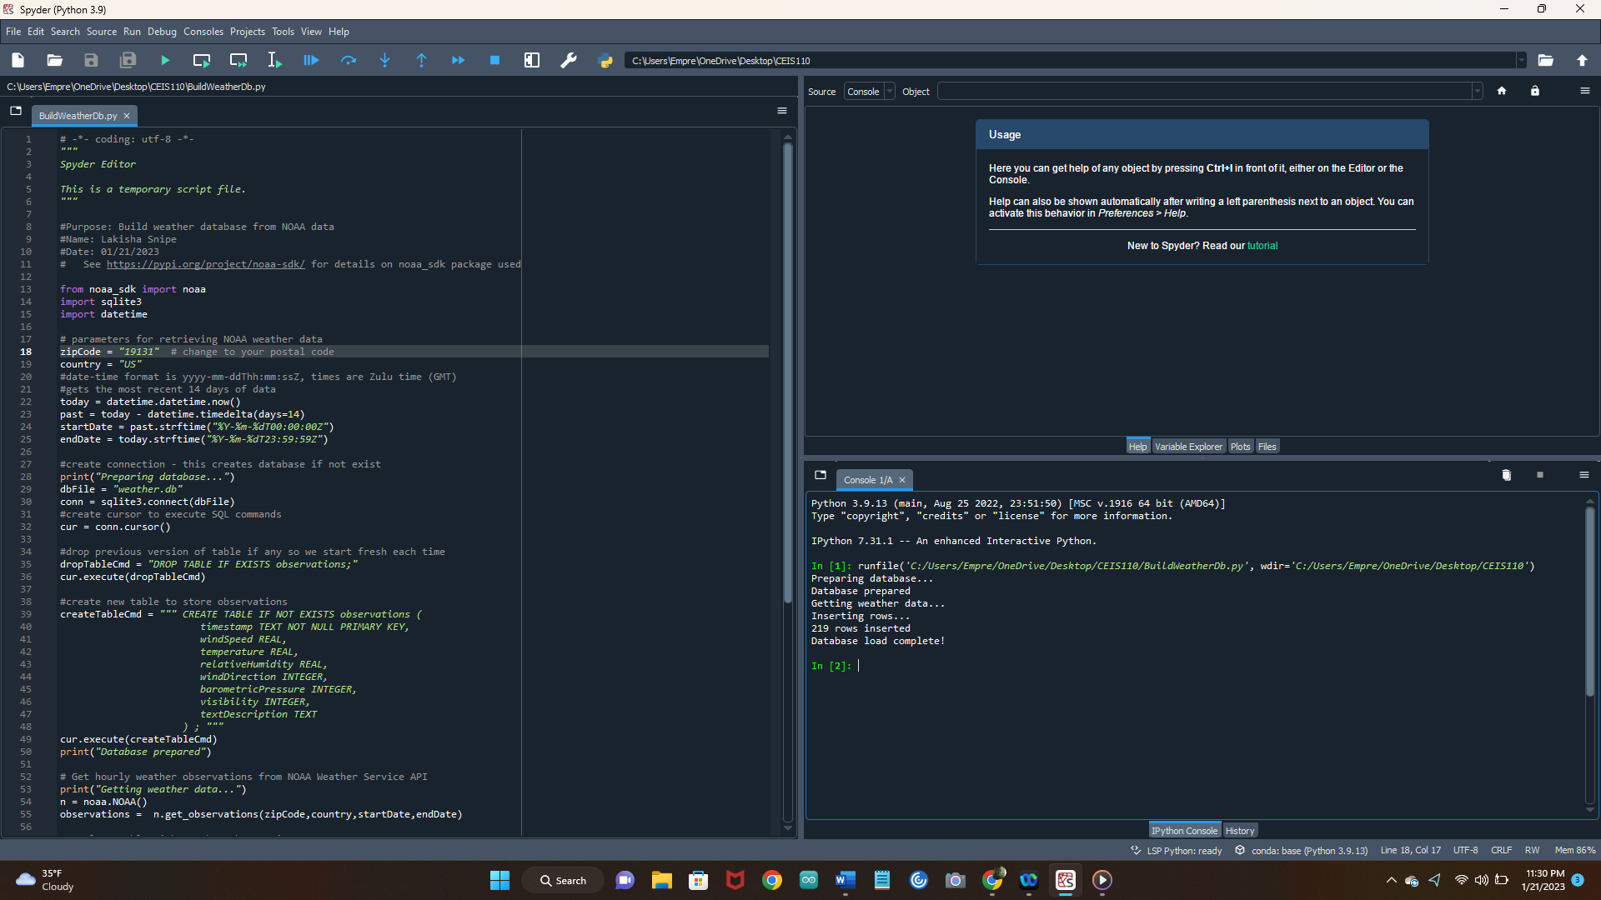
This is a screen shot of the Python code executed successfully of the weather.Db database. The code will create a table named observations with several fields in it

Slide 8
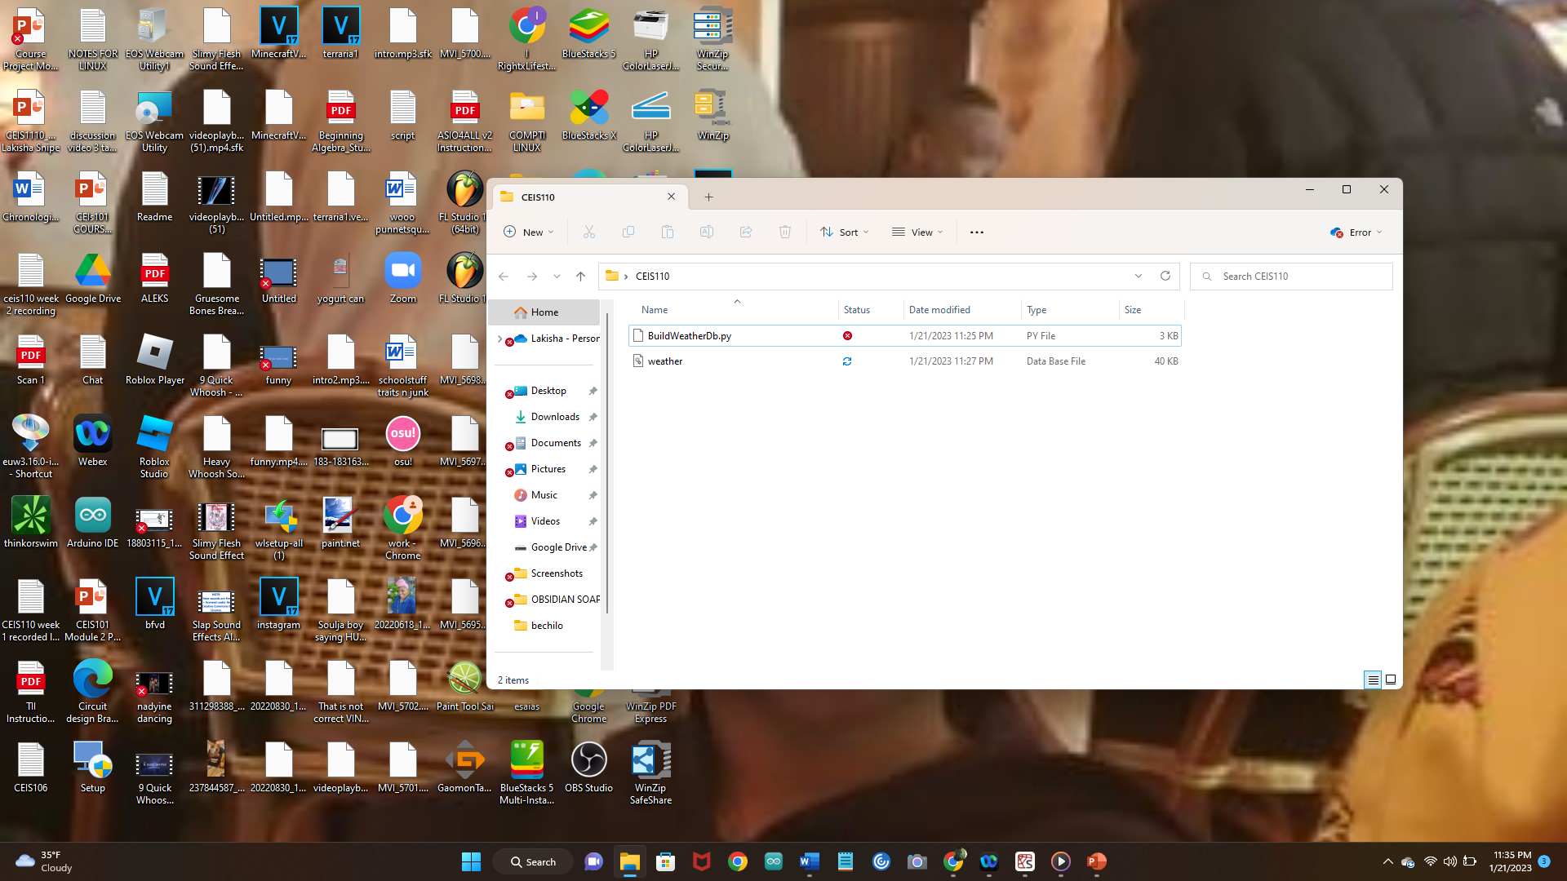
This slide represent the buildweather.Db file being created

Slide 9
Querying the database with SQL

Slide 10
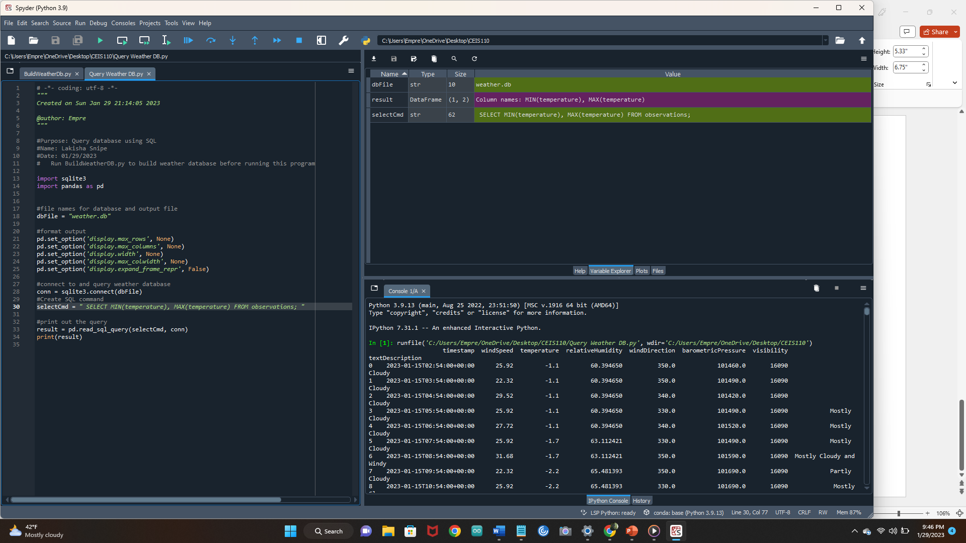
Query to retrieve all columns and all rows

Slide 11
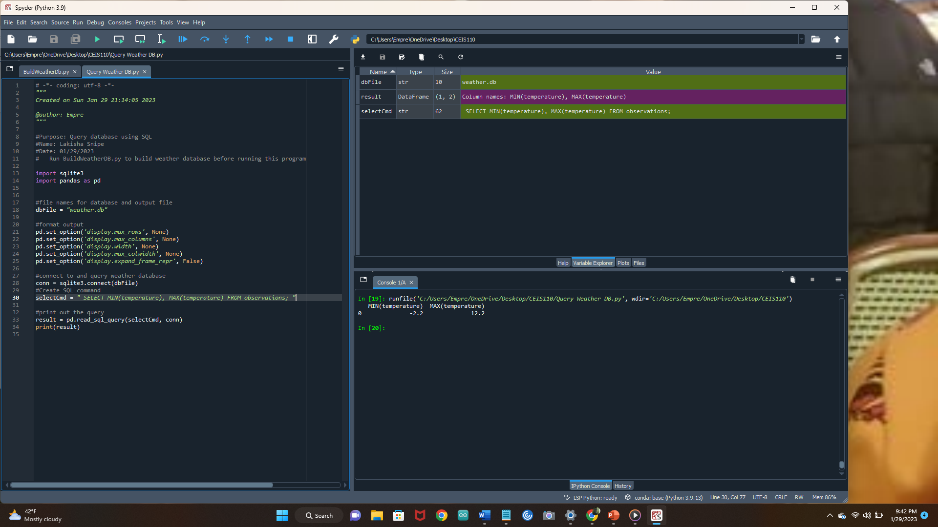
Query to retrieve lowest and highest temperatures

Slide 12
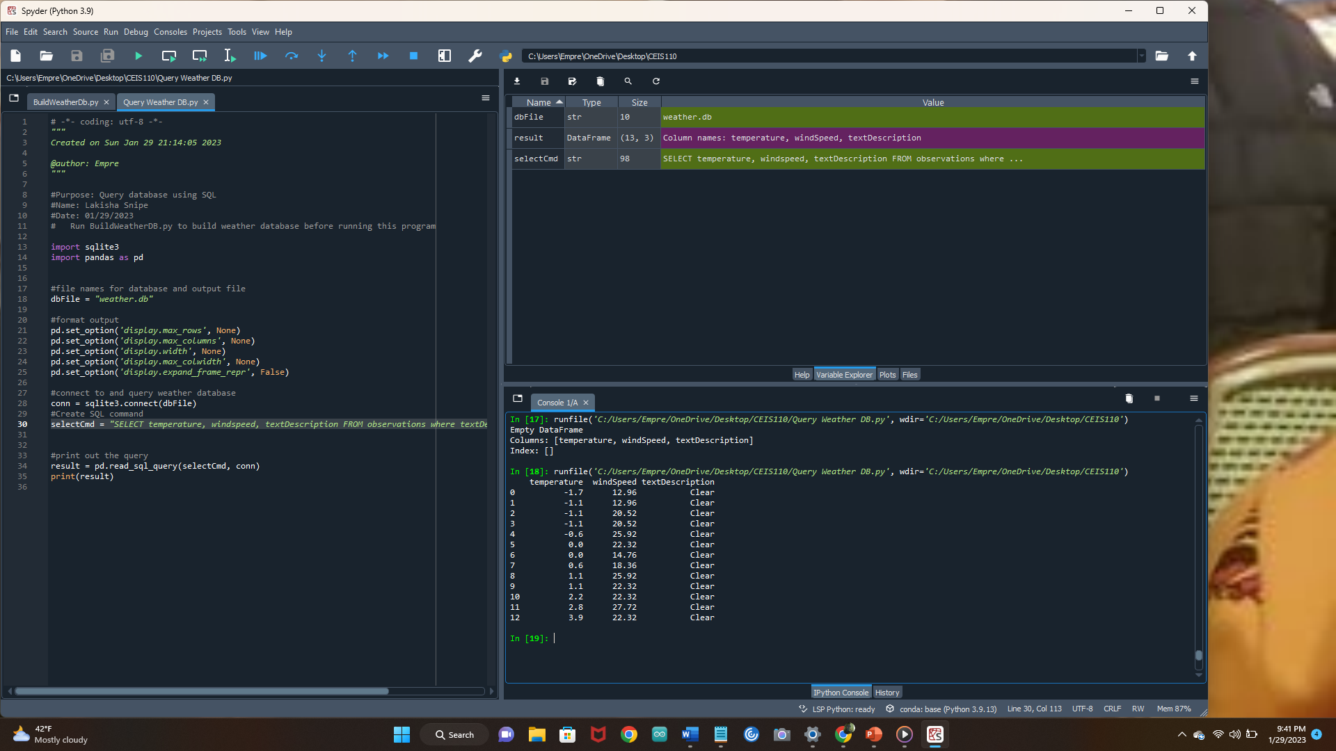
Query to retrieve all clear days

Slide 13
Querying and manipulating data with SQL and Python

Slide 14
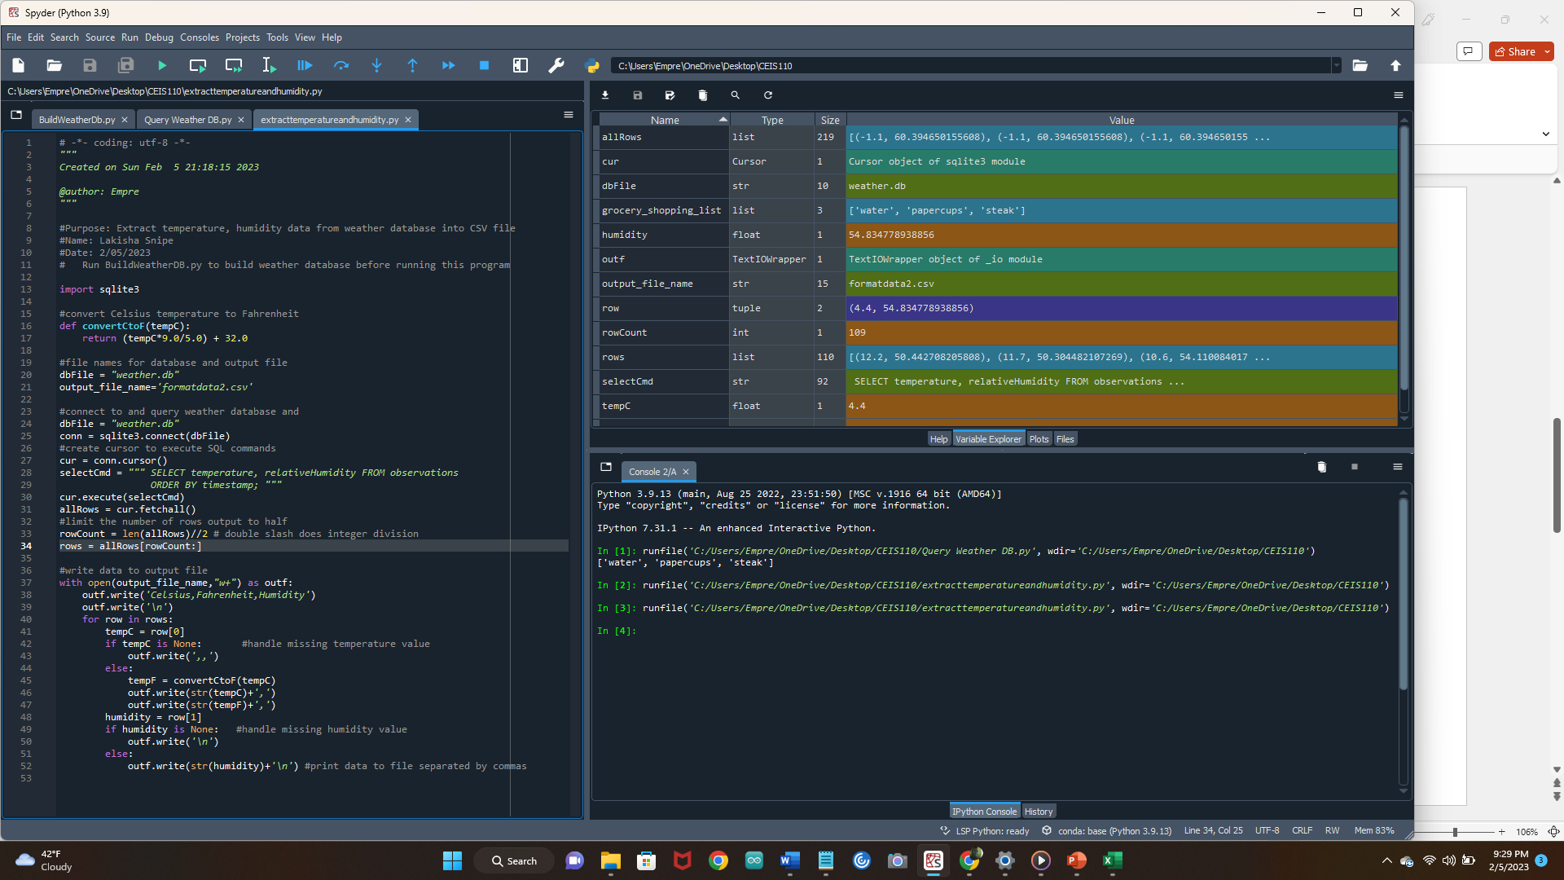
ExtractTempHumidity.py Python code. To record the humidity of my city.

Slide 15
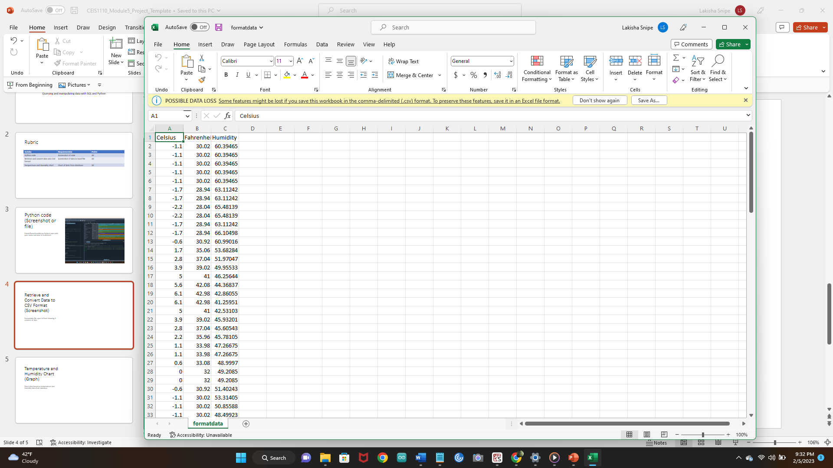
Taking weather data and charting it into Excel.

Slide 16
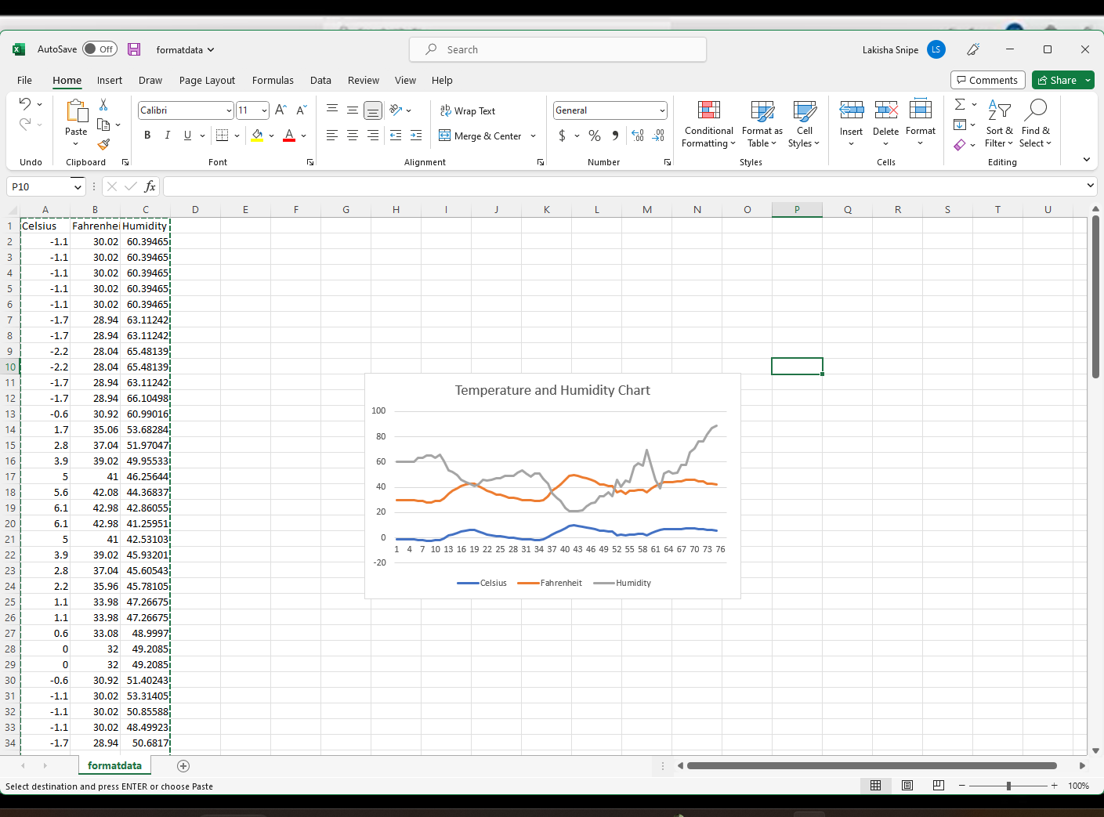
Temperature and Humidity Chart (Graph). Taking the information from Python and converting it into a line graph.

Slide 17
Developing Graphical Models and Interpreting Results

Slide 18
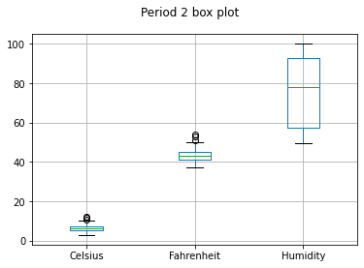
Code and screen shot to find results of humidity in my city using a box graph.
import pandas as pd
import matplotlib.pyplot as plt
df2 = pd.read_csv("formatdata2.csv")
df2.boxplot(); plt.suptitle('Period 2 box plot')
plt.show()
print(df2.describe())
print(df2.info())

Slide 19
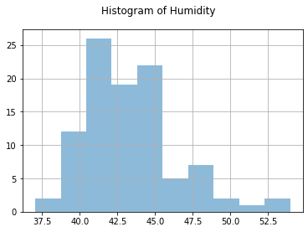
Plot and code used to generate information for a histogram of humidity
import pandas as pd
import matplotlib.pyplot as plt
df1 = pd.read_csv("formatdata.csv")
df2 = pd.read_csv("formatdata2.csv")
df2['Fahrenheit'].hist(bins=10, alpha=0.5); plt.suptitle('Histogram of Humidity')
plt.show()

Slide 20
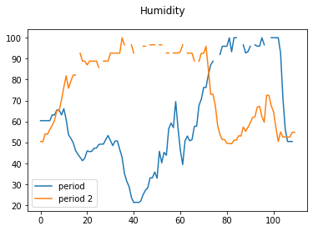
Analysis
Think of your own question and create a chart/graph to answer it
Your own question:
What are the differences in humidity between the two periods? Throughout period one the humidity was more unstable where in period two in the beginning of the week it went from 50 to a little over 80 and kind of stayed more consistent between 90 and 100 until the end of the week when it dipped back down to around 50

Slide 21
Prediction Using Data Analytics from the information that was gathered from my plots using my zip code.
Develop a prediction based on the data. What variations in temperature and humidity do you expect over the next few hours or days? How would humidity change if temperature goes up or down?
Based on the temperature the humidity is going to increase. From experience during this time of year the warmer it is the likely hood of it raining and it being more humid than usual for this time of year.

Slide 22

Challenges
The challenges I had with learning Python coding was just understanding the language over all. Some things were easy to grasp and other commands were very difficult especially this being an accelerated program. I believe with more training and practice I will be proficient in Python and have the confidence to go out in the real world and perform very well. There are many careers I could obtain with the knowledge that I learned with Python being that it is a very popular coding language. I could make custom websites and apps for clients. I could write programs for back end technology for Cyber Security. There are lots of advantages also because I think it will be easier for me to learn other coding languages similar to Python.
In conclusion, Python's simplicity, versatility, and community-driven development have made it a popular high-level programming language. Its widespread use in various industries, coupled with its open-source nature and large community of developers, make it an excellent choice for both beginners and experienced programmers.

